Slide 1



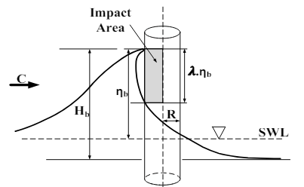

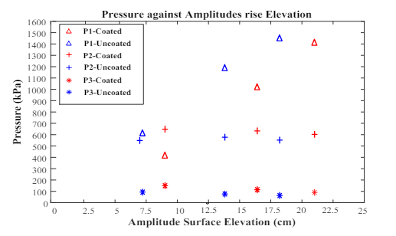
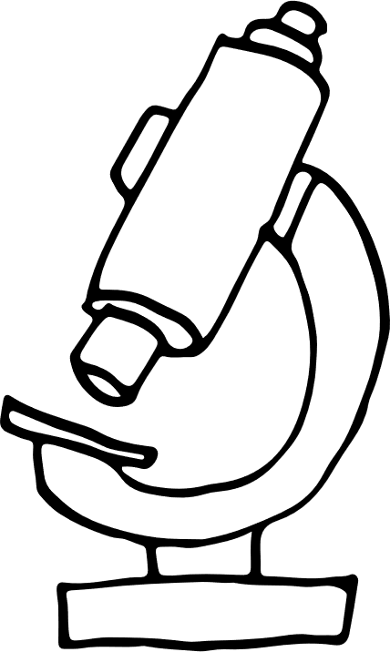


YILDIZ TECHNICAL UNIVERSITY
FACULTY OF NAVAL ARCHITACTURE AND MARITIME
DEPARTMENT OF MARINE ENGINEERING
THESIS
110A1234 Ahmet SAVCI 120A1234 Yaşar Şahin
ADVISER : Assoc. Prof Dr. Tarık KOÇAL
Wave Impact on Offshore Structures
44%
This study presents experimental research on the wave forces affecting cylindrical legs on offshore platforms.
35%
66%
The aim was to determine pressure distributions and deformations in the surface properties of altered cylinders.
Of graduates earn more income.
As seen in Figure, the time taken for the collision on each cylinder differs due to their surface characteristics. The pressure impact on the cylinder is proportional to the cylinder’s surface elevation in both cases.
The findings suggest that surface modifications can significantly impact the response of cylindrical structures to wave forces, providing valuable information for offshore platform design and maintenance.
We recommended conducting further tests at higher elevations to verify the findings near the Still Water Level. Further studies are needed to evaluate the reciprocations of using coatings in practical applications. It is. Thoughts, projections or ideas of the authors about cost and feasibility of hydrophobic coating may be inserted essential to consider sources of uncertainty such as measurement uncertainty, sensor positioning, and variability in environmental conditions during the experiment there.

